Slide 1
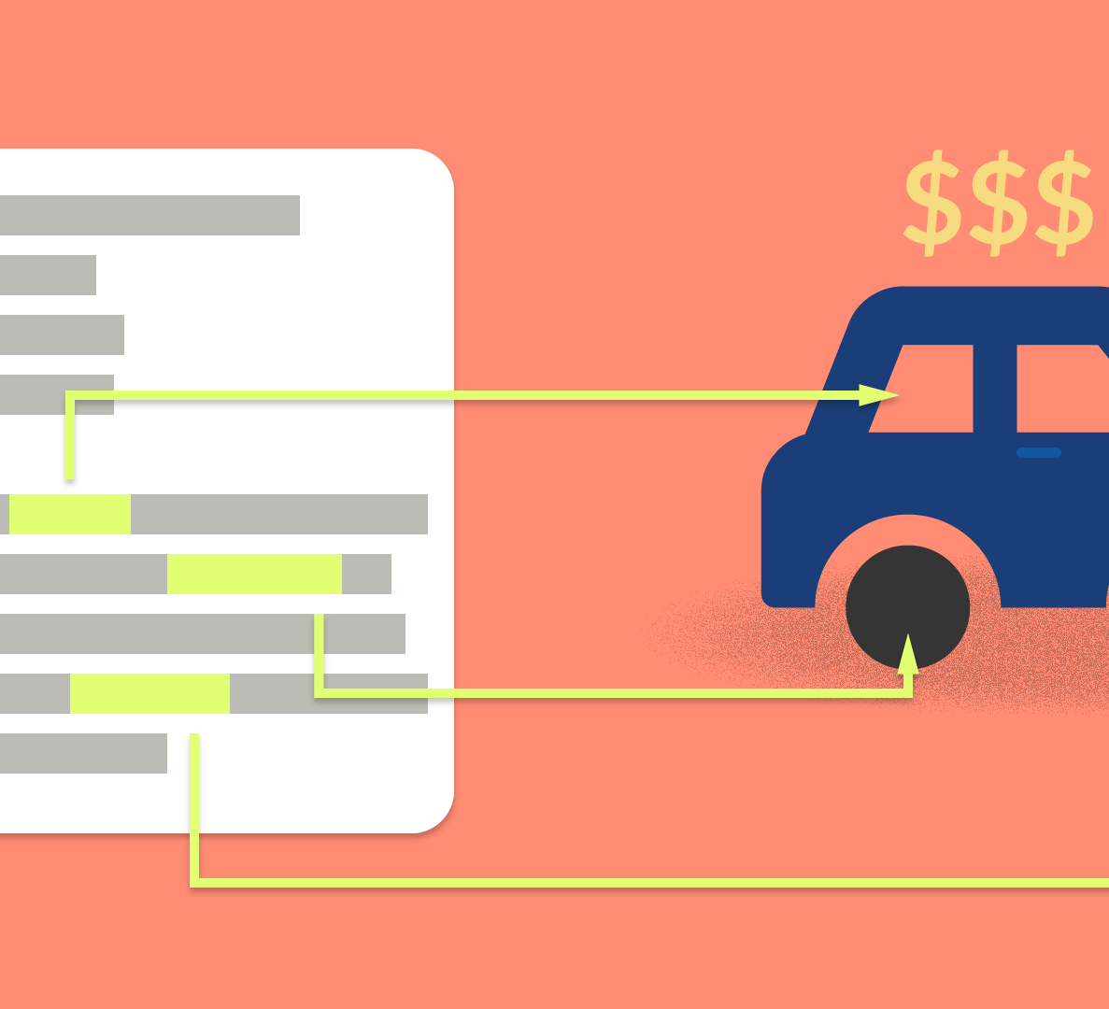
Used Car: price prediction

Slide 2
SUBMITTED BY Steffin Varghese

Slide 3
INTRODUCTION
Business Problem Framing
With the covid 19 impact in the market, we have seen lot of changes in the car market. Now some cars are in demand hence making them costly and some are not in demand hence cheaper. One of our clients works with small traders, who sell used cars. With the change in market due to covid 19 impact, our client is facing problems with their previous car price valuation machine learning models. So, they are looking for new machine learning models from new data.

Slide 4
Understanding the Problem
Used car selling market was always a booming market. With the rise to auto owners, the market for the used cars always increased. Thus, there is always a demand and supply of cars in the used car market. Everything was running smoothly before the wide spread of Covid 19. After the pandemic, every market including the automobile industry became the victim and incurred a knock. Due to the inflation, economic instability, etc., the car prices have been varying in short span of time. So, buyers and sellers are not able to analyse the market condition or make the proper valuation of car price. This has been resulting in over-pricing and under-pricing of the cars in the used car market.
Data Science as always, will be a great way to analyse and identify the changing trends in the domain This will be helpful in identifying the patterns for the proper valuation and making predictions of car price according to various crucial factors which are affecting the car price using the historical data and theory of probability. With the help of machine learning, we can create a model that can predict the price of car by using several inputs which consists of prominent features of the cars.

Slide 5
Steps in Exploratory Data Analysis
Loading the Dataset
Handling the Null Values
Visualization
Applying the PCA Techniques
Data Cleaning
Encoding the categorical variables

Slide 6
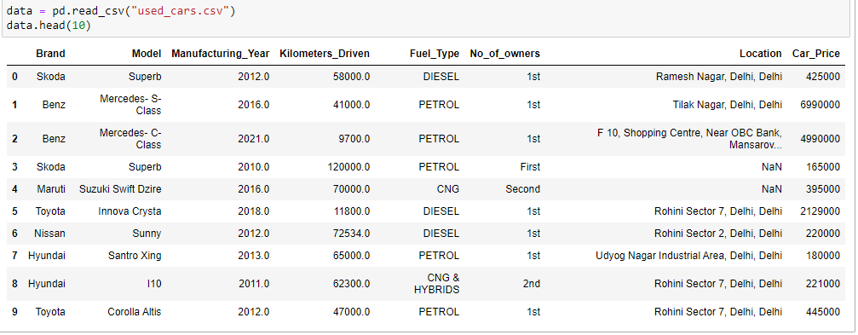
Data Sources and their formats
The project requirement consists of two phases: -
a. Data Collection Phase b. Model Building Phase.
We have scraped used cars data for 5270 cars from three websites: -
a. Olx.in b. Cardekho.com c. Cars24.com
The data has included all types of cars such as SUV, Sedans, Coupe, minivan, Hatchback etc.
With the help of Selenium Web Scraping Library, we were able to scrape the required details about every car which helped us to gather the information from the three websites.
Dataset – used_cars.csv. We have to test and train the algorithm with this dataset to create the model.
We have 5270 rows and 8 columns in the dataset.
We have string, float, and integer type of data in the dataset.
We have 5270 non null values in columns ['Brand', 'Car_Price']

Slide 7
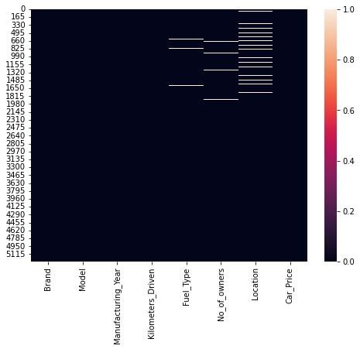
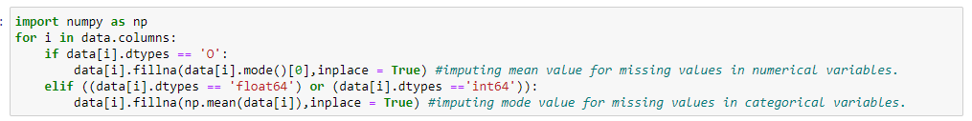
Data Preprocessing
Checking and removing missing Values
Imputation of mean and mode value for missing values in dataset
We imputed the mean value for missing values in numerical columns and mode value of column for missing values in categorical columns in dataset.
Missing data in train dataset

Slide 8
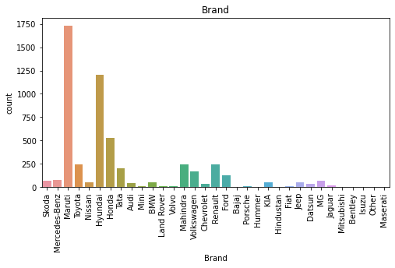
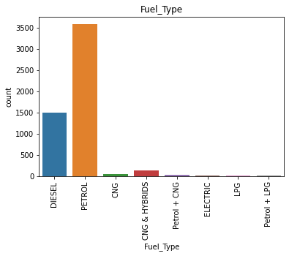
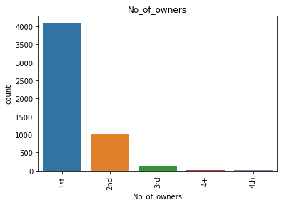
Data Visualization
Univariate Analysis- Categorical Variables
Observations:
Most of the cars which are available for sale is from Brand "Maruti". Second highest cars which are available for sale is from 'Hyundai'. These are the two major car sellers in the country.
Most of the cars which are available for sale are petrol powered. Second most cars which are available for sale are using diesel fuel type.
Most of the cars which are available for sale are single owner vehicles.

Slide 9
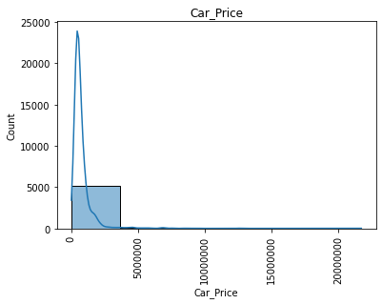
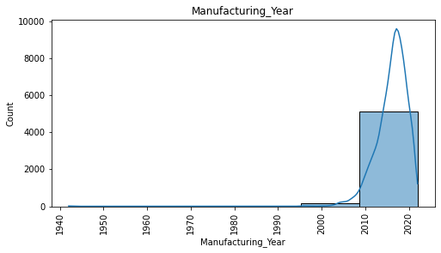
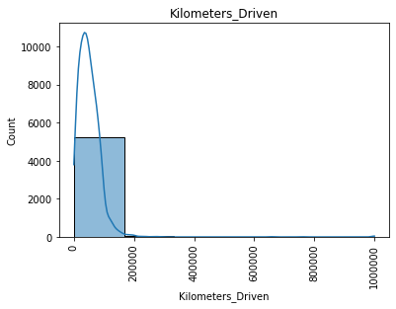
Histogramplot – Numerical Variables
Observations:
Most of the cars which are available for sale are manufactured from 2008 to 2022.
Most of the cars which are available for sale have been driven less than 1.67 lakh Kilometres.
Most of the cars which are available for sale are having a price ranging between Rs15,000 to Rs36.3 Lakh.

Slide 10
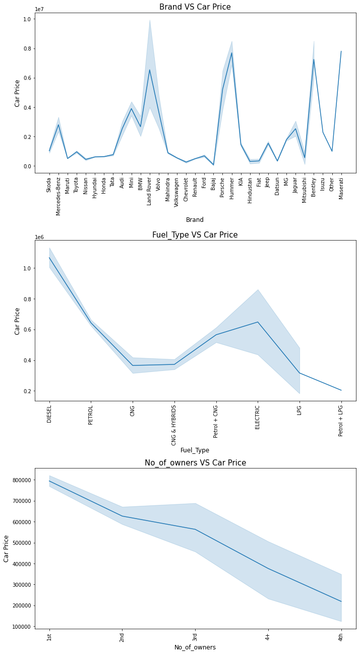
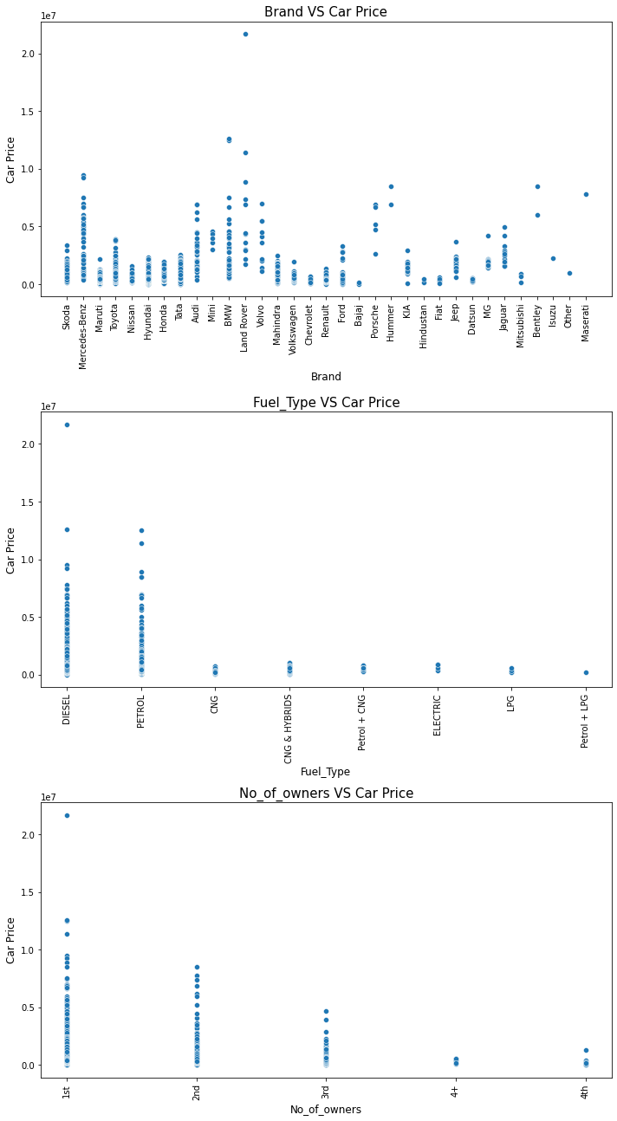
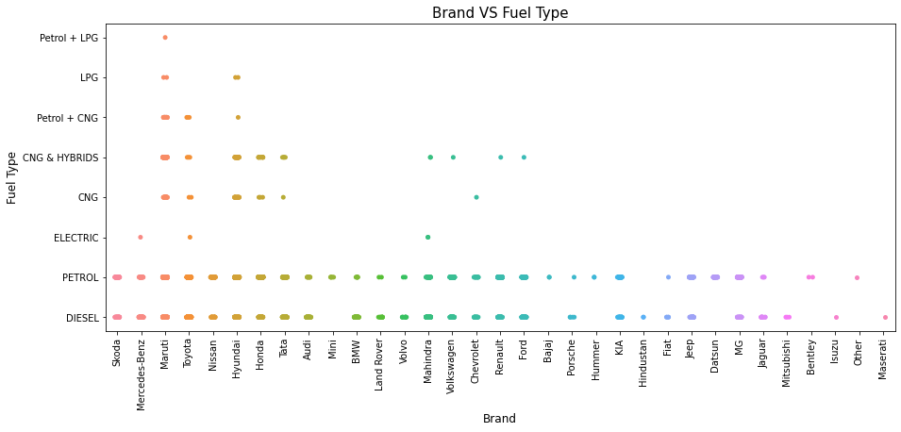
Bivariate Analysis

Slide 11
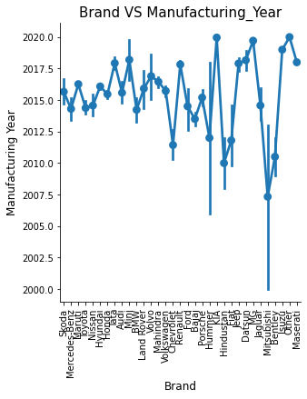
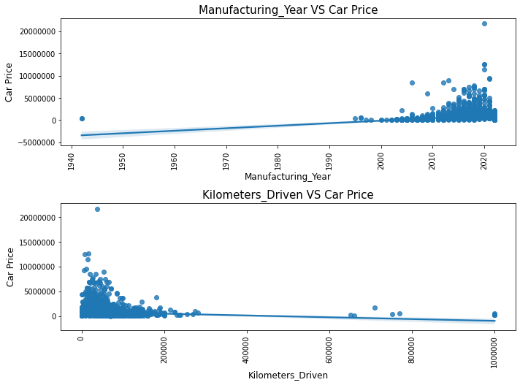
Observations
The sale price of car is increasing if the car was recently manufactured.
The sale price of car is slightly decreasing for the cars which have been driven most.
The price for the luxurious car brands like Mercedes-Benz, BMW, Land Rover, Hummer, Bentley are higher compared to other brands.
The car price for diesel, and petrol fuelled cars are having higher price compared to other types fuelled cars.
The price of car is decreasing as the number of owners of the cars are increasing. Most of the cars.
Maruti is having different fuel type cars which are available for sale. Toyota and Hyundai are also having a variety of cars which are powered by several types of fuel.
Most of the cars which are available for sale are manufactured after 2015 and most of the cars are of brands like KIA, MG which are available for sale were manufactured after the year 2019.

Slide 12
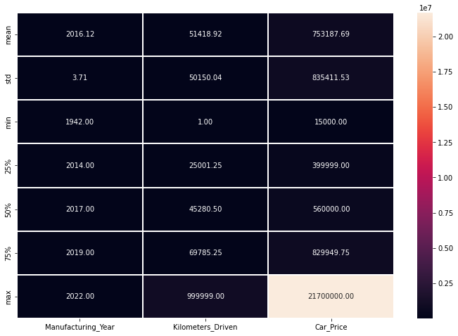
Statistical Summary
Describe of the data
Observations:
The mean of the columns ['Kilometers_Driven','Car_Price'] are higher than the median value. That means the distribution of values in these columns are not normal and skewness is present in the data distribution.
The max value of the columns ['Kilometers_Driven','Car_Price'] are having enormous difference between the 75%. Possible outliers are present in the data of these columns.

Slide 13
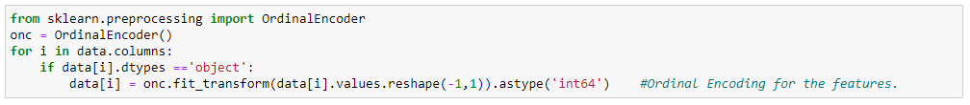
Encoding the Categorical Columns
Encoding the Categorical Variable data
We have encoded the categorical columns of the dataset.

Slide 14
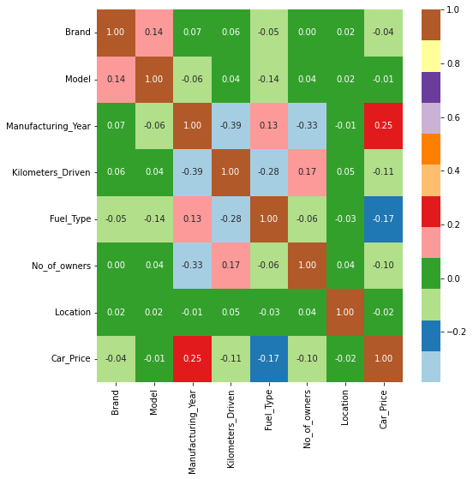
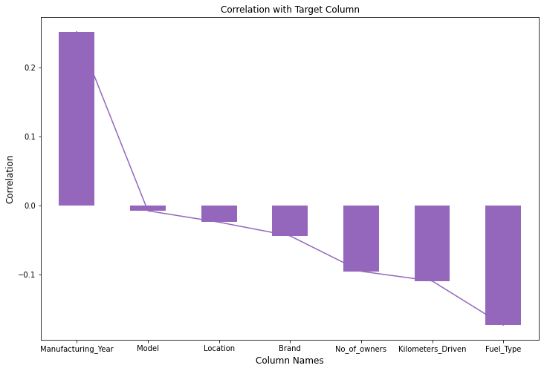
Correlation
Correlation of Variables with Target Variable
Correlation of Data Variables

Slide 15
Correlation
Manufacturing_Year 0.251655
Model -0.007641
Location -0.024122
Brand -0.043915
No_of_owners -0.095251
Kilometers_Driven -0.109295
Fuel_Type -0.173148
Observations:
Except the column 'Manufacturing_Year', rest of the columns are having a negative correlation to the target variable 'Car_Price'.
The column "Manufacturing_Year' is having the highest positive correlation to the target variable 'Car_Price'. The column 'Fuel_Type' is having highest negative correlation to the target variable 'Car_Price'.
The column 'Model' is having least negative correlation to the target variable 'Car_Price'.

Slide 16
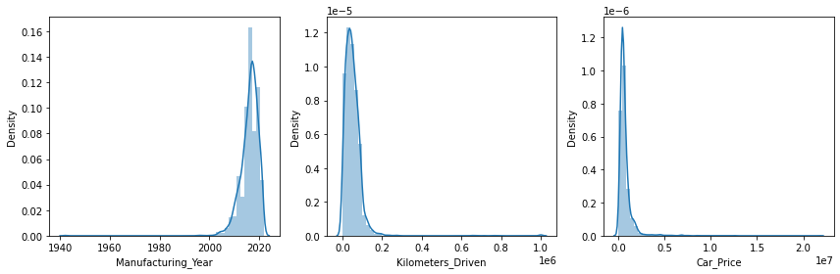
Distribution of Data in Numerical Columns
Distribution of Data in Numerical Columns
The data in columns are not normally distributed.
Skewness is present in the data of all numerical columns.

Slide 17


Data Cleansing
Assumptions Related to the Problem Under Consideration
Removing the skewness with power transform
Numerical columns in dataset with skewness beyond +/-0.5 standard limit
After removing the skewness from the data using standard scaler and power transform our data looks like this:
Skewness of the dataset

Slide 18
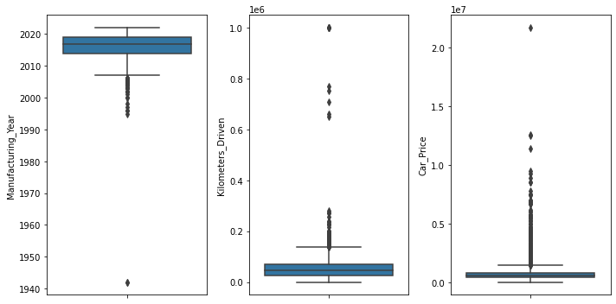
Presence of Outliers in Data
Outliers are present in the data of all the numerical columns.
Since the column 'Car_Price' is our target variable, we will not remove the outliers from this column.
Presence of Outliers in Numerical Variables
Removed Outliers in the datasets
We have used two methods for outlier removal method:
Outlier removal using ZScore Technique
Outlier removal using IQR (Inter Quartile Range) Technique.
0.34% of the data loss is incurred after removing outliers using zscore outlier removal method. 0.27% of data loss is incurring after removing outliers using IQR outlier removal method. So, the IQR method is slightly better as it is losing the less data from the dataset after removing outliers.

Slide 19
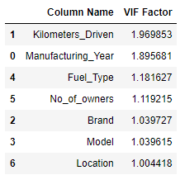
Checked and Removed Multicollinearity from the Datasets.
We can see that none of the columns are having variance inflation factor higher than 5. That means there is no or least multicollinearity existing between the variables in the dataset.
VIF Factor of Variables

Slide 20
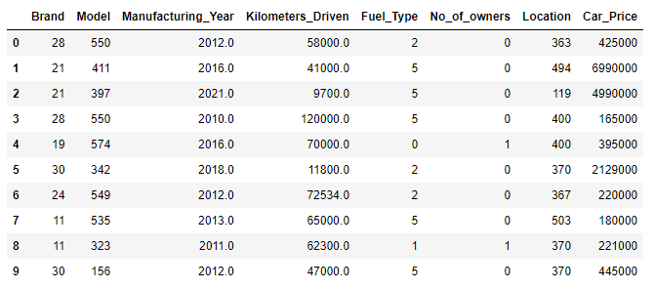
Final Dataset
Snapshot of final dataset after pre-processing and data cleaning

Slide 21
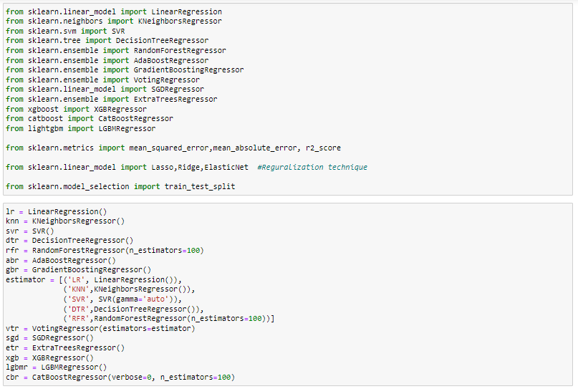
Model/s Development and Evaluation
We created three functions for testing the model and for cross validations:
best_ran : Finding the best random state for the selected model
mod_test : Ttraining the model with the train data using the best random state.
cross_val : Finding the best cross validation mean score for each model.

Slide 22
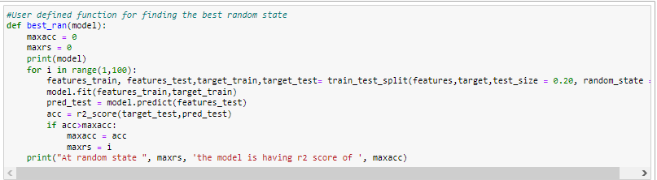
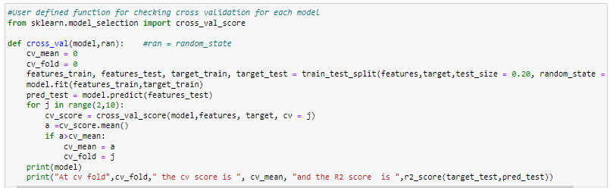
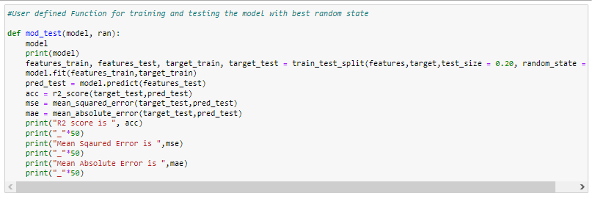
Testing of Identified Approaches (Algorithms) and evaluation of selected models
Code Snippet for function to find best random state
Code Snippet for function to find the cross validation mean score
Code Snippet for function to test the model

Slide 23
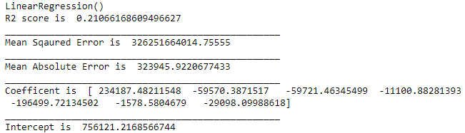
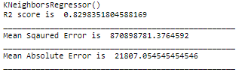
Model DashBoard
Linear Regression
KNeighborsRegressor
Model Test Performance
Model Test Performance
LinearRegression ()
At cv fold 7 the cv score is 0.1602592086826202 and the R2 score is 0.21066168609496627
KNeighborsRegressor ()
At cv fold 6 the cv score is 0.06286766980008612 and the R2 score is 0.4090443620841965

Slide 24
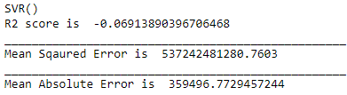
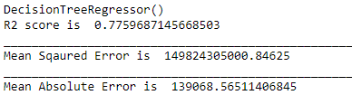
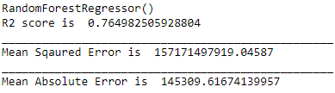
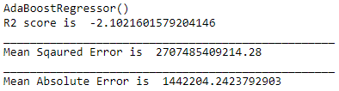
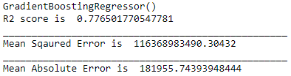
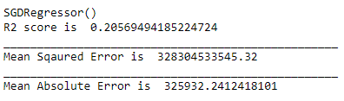
SVR
DecisionTree Regressor
RandomForest Regressor
Model Test Performance
Model Test Performance
Model Test Performance
SVR ()
At cv fold 0 the cv score is 0 and the R2 score is -0.06913890396706468
DecisionTreeRegressor ()
At cv fold 0 the cv score is 0 and the R2 score is 0.7638812386427065
RandomForestRegressor ()
At cv fold 8 the cv score is 0.23267864095587695 and the R2 score is 0.7813948565775681
AdaBoostRegressor
GradientBoostingRegressor
SGDRegressor
Model Test Performance
Model Test Performance
Model Test Performance
AdaBoostRegressor ()
At cv fold 0 the cv score is 0 and the R2 score is -1.5142886069794743
GradientBoostingRegressor ()
At cv fold 9 the cv score is 0.38589722085427625 and the R2 score is 0.7843173363863506
SGDRegressor ()
At cv fold 7 the cv score is 0.17142521509148537 and the R2 score is 0.21093491106151396

Slide 25
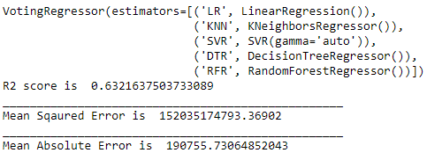
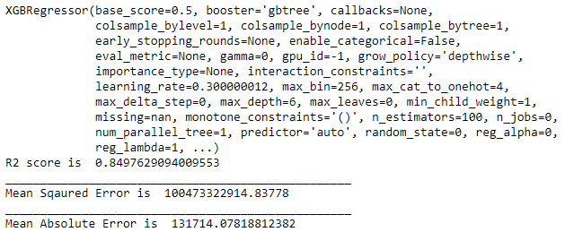
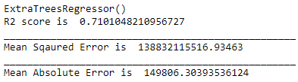
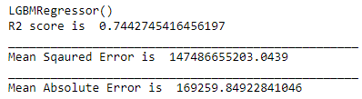
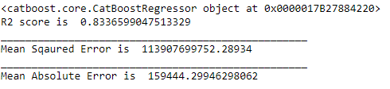
VotingRegressor
XGBRegressor
Model Test Performance
VotingRegressor ()
At cv fold 6 the cv score is 0.4911523166557685 and the R2 score is 0.6396968402159033
Model Test Performance
XGBRegressor ()
At cv fold 8 the cv score is 0.4693459414674942 and the R2 score is 0.8497629094009553
ExtraTreesRegressor
LGBMRegressor
CatBoostRegressor
Model Test Performance
Model Test Performance
Model Test Performance
ExtraTreesRegressor ()
At cv fold 8 the cv score is 0.223767983819791 and the R2 score is 0.7168263341404635
LGBMRegressor ()
At cv fold 9 the cv score is 0.4218253298532209 and the R2 score is 0.7442745416456197
CatBoostRegressor ()
At cv fold 6 the cv score is 0.5064668304560532 and the R2 score is 0.8336599047513329

Slide 26
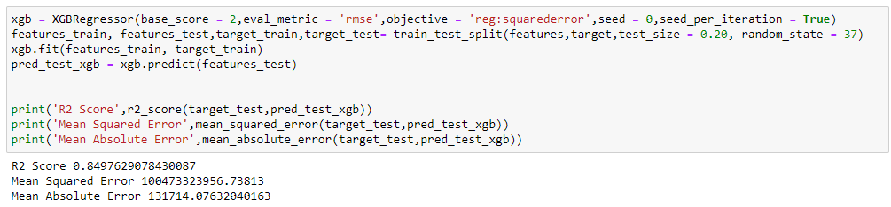

Finalized Model
After all the tests, cross validations, regularization and hyperparameter tuning the XGBoost model is performing well. So, we can consider this model as the best performing model.
Snapshot of performance of the final prediction model
Saving the best model
We have saved the machine learning model for future predictions. We have serialized and saved the binary file as “Used_car_price_prediction_model.pkl” using the pickle library.

Slide 27
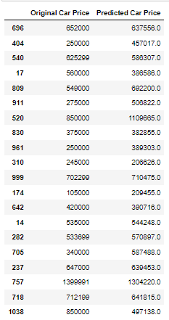
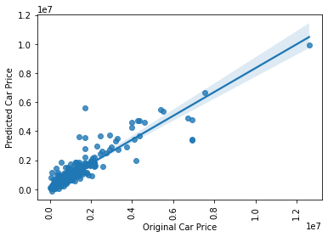
CONCLUSION
To test the accuracy of the model, we have made predictions on the dataset with the features of cars. Since the target variable (car price) is already available, we can cross verify the predicted values with the actual values.
Line of Best Fit
Our model is performing well with predictions and provided almost accurate results. The XGBoost Regressor model(xgb) is providing a final R2 Score of 84.98%.
Actual and Predicted Values

Slide 28
Key Findings and Conclusions of the Study
With the help of data science and machine learning, we were able to create a machine learning model using XGBoost algorithm, which can predict the used car price.
Now this model can be used to predict the price of used cars in India with the following variable information about the house. (Important Variables)
Brand Model Manufacturing_Year Kilometers_Driven
Fuel_Type No_of_owners Location Car_Price
Impact of Variables on Target Variable (Correlation)
The column "Manufacturing_Year' is having the highest positive correlation to the target variable 'Car_Price'. The column 'Fuel_Type' is having highest negative correlation to the target variable 'Car_Price’.
The column 'Model' is having least negative correlation to the target variable 'Car_Price’.
Except the column 'Manufacturing_Year', rest of the columns are having a negative correlation to the target variable 'Car_Price'. Higher the contribution of these variables for a car will result in the decrease in the car price.

Slide 29
Limitations of this work and Scope for Future Work
Limitations
The dataset included many key features about the used cars which helped us in the prediction of car price. But still there are many other features that has been left out which could help to improve the efficiency of the model such as milage, engine power etc.
The used car markets are always fluctuating and always prone to changes. Even though we have included many salient features, there are other factors such as economic conditions, availability of cars service centres, spare parts prices and availability, inflation etc.
The source of dataset was limited to three websites and popular cities. The prices may vary for other websites, and remote areas.
The data was noisy, and we had to remove several data while the process of cleaning and pre-processing. This has altered the true nature of the data.
Scope
The used car market is volatile to market and economic conditions, the trends, and patterns in this market changes over time. Since we have created a machine learning model for forecasting the used car price valuation, there is always an option for recalibration. So, we can always analyse the market and include the latest trends or features that are affecting the price of the used cars.
Our model is scalable and can be improved by including more data and adding more features. We can also collect data from various websites and include many other unpopular cities for improving the model accuracy in prediction.
Since the data science is growing over time, we can adapt to new features and possibilities that will help us creating a powerful model in predictions. With automation using machine learning, we are saving time, effort and incurring less errors.

Slide 30
Thank You

